Slide 1
Елена Пикунова, New Business & New Media Director
Мобильная реклама:
разочарования рынка
Notes:
To change the image behind the red box:
On the MASTER slide, select the image. Click the PICTURE TOOLS tab, then Format > Change Picture and navigate to the image you wish to use.
Images should be 10”w x 7.5” h. If your image is not, do not use the Change Picture command, as it will distort the image to fit the box.
To use an image that is not correctly sized:
Delete the background image. Use the Insert command to place your image. With the image selected, click the small button in the lower right of the Size tab and use the dialog to size the image as closely as possible to 10”x7.5” Close. Keep the image selected and use the Crop tool in the Size tab to crop the image to the correct size.

Slide 2
1| Исследования
Notes:
To change the image behind the red box:
On the MASTER slide, select the image. Click the PICTURE TOOLS tab, then Format > Change Picture and navigate to the image you wish to use.
Images should be 10”w x 7.5” h. If your image is not, do not use the Change Picture command, as it will distort the image to fit the box.
To use an image that is not correctly sized:
Delete the background image. Use the Insert command to place your image. With the image selected, click the small button in the lower right of the Size tab and use the dialog to size the image as closely as possible to 10”x7.5” Close. Keep the image selected and use the Crop tool in the Size tab to crop the image to the correct size.

Slide 3
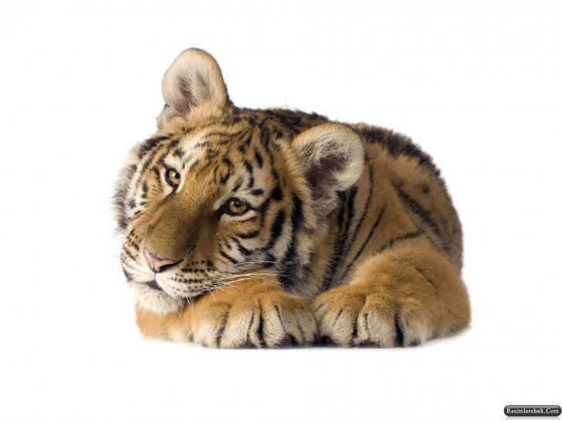
TNS Gallup, ComScore, Openstat, J’son&Partners
Единое исследование рынка, на которое опирается рекламодатель медийной рекламы, отсутствует
Есть только частные (точечные исследования)
Методики исследований разнятся, и не всегда корректны
Данные одной исследовательской компании оспариваются другой компанией

Slide 4
2 | Ценообразование и форматы
Notes:
To change the image behind the red box:
On the MASTER slide, select the image. Click the PICTURE TOOLS tab, then Format > Change Picture and navigate to the image you wish to use.
Images should be 10”w x 7.5” h. If your image is not, do not use the Change Picture command, as it will distort the image to fit the box.
To use an image that is not correctly sized:
Delete the background image. Use the Insert command to place your image. With the image selected, click the small button in the lower right of the Size tab and use the dialog to size the image as closely as possible to 10”x7.5” Close. Keep the image selected and use the Crop tool in the Size tab to crop the image to the correct size.

Slide 5

Охватные площадки, селлеры, тематические площадки
Нет единых цен на одинаковые форматы похожих площадок
Для создания 1 крупной рекламной кампании нужно создать от 5 до 20 разных баннеров
Не существует баинговых стандартов на рынке

Slide 6
3 | Статистика
Notes:
To change the image behind the red box:
On the MASTER slide, select the image. Click the PICTURE TOOLS tab, then Format > Change Picture and navigate to the image you wish to use.
Images should be 10”w x 7.5” h. If your image is not, do not use the Change Picture command, as it will distort the image to fit the box.
To use an image that is not correctly sized:
Delete the background image. Use the Insert command to place your image. With the image selected, click the small button in the lower right of the Size tab and use the dialog to size the image as closely as possible to 10”x7.5” Close. Keep the image selected and use the Crop tool in the Size tab to crop the image to the correct size.

Slide 7

AdRiver, AdFox, NMMR, статистика сетей и площадок
Нет единой он-лайн статистики, доверительного бренда-платформы, которая бы объединила статистику крупной РК
Вся статистика по крупным РК – ручная
Сетевые трекинги у всех сетей разные, нужно на кампанию ставить от 1 до 5 пикселей

Slide 8
4 | Эффективность и доверие

Slide 9
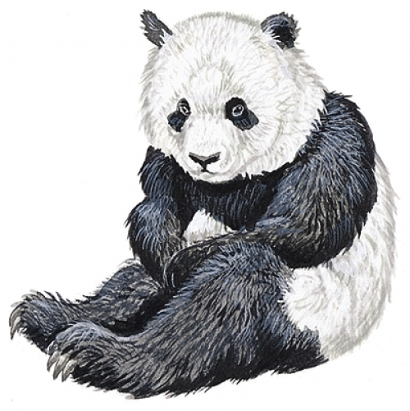
Медийные кампании: весь инструментарий
Эффективность рекламной кампании не измерима по результатам проведения медийной кампании
При неправильном прогнозировании площадок, результаты могут не совпадать на 70-80%
Эффективность рассылок низкая по отношению к прогнозам
Доверие к медиа падает

Slide 10
Пикунова Елена
New Business&New Media Director
Skype: Elena.Pikunova
Tel: +7-926-900-75-42
Notes:
To change the image behind the red box:
On the MASTER slide, select the image. Click the PICTURE TOOLS tab, then Format > Change Picture and navigate to the image you wish to use.
Images should be 10”w x 7.5” h. If your image is not, do not use the Change Picture command, as it will distort the image to fit the box.
To use an image that is not correctly sized:
Delete the background image. Use the Insert command to place your image. With the image selected, click the small button in the lower right of the Size tab and use the dialog to size the image as closely as possible to 10”x7.5” Close. Keep the image selected and use the Crop tool in the Size tab to crop the image to the correct size.

